Slide 1

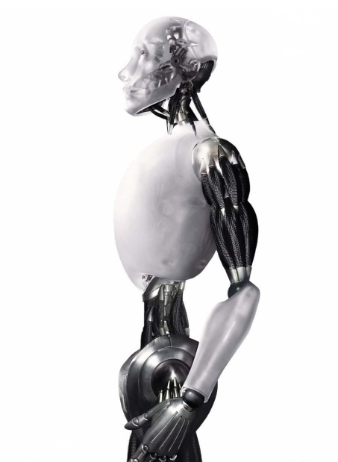
Convolutional Neural Networks
布树辉 bushuhui@nwpu.edu.cn
http://www.adv-ci.com

Slide 2


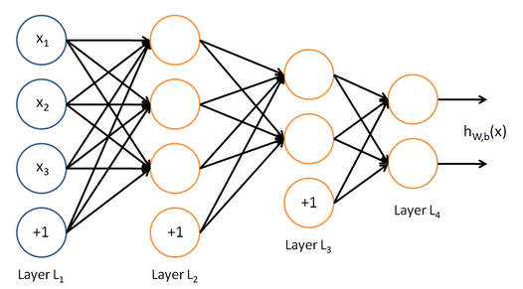

Neural networks
Neural networks
sample
label
A
B
C

Slide 3
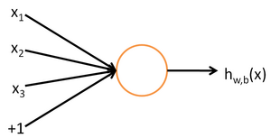
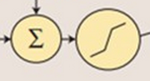
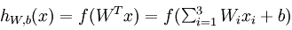
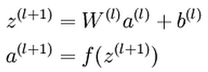
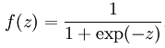
Neural networks - feedforward networks

Slide 4
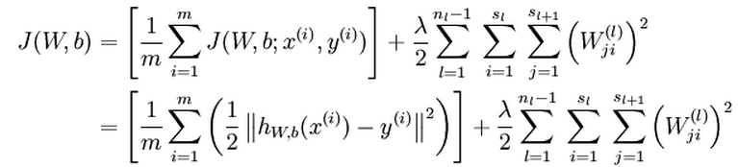
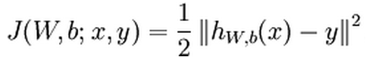
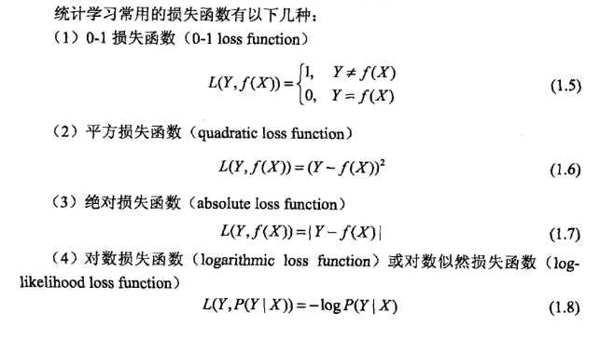
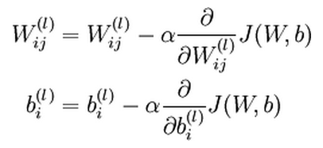
Neural networks - Network training
Cost function of Single training example
Cost function of all examples
Gradient Descent

Slide 5
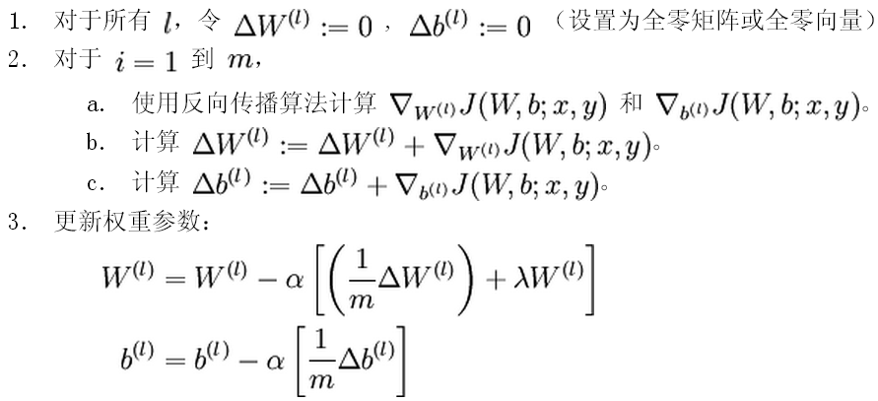
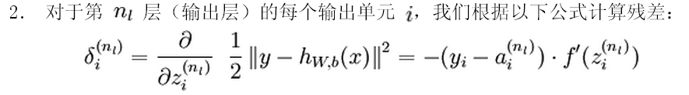
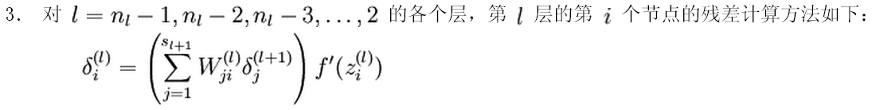
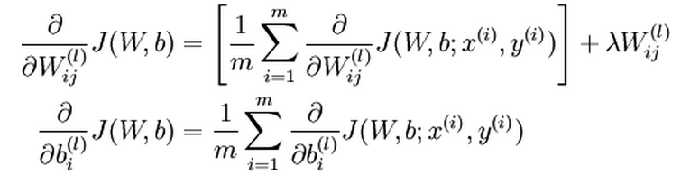
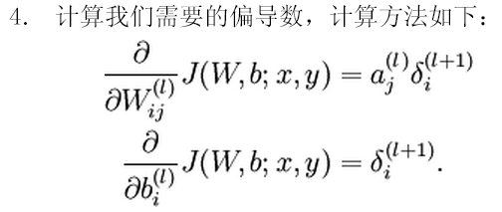
Neural networks - Gradient Descent
UFDL: http://ufldl.stanford.edu/wiki/index.php/Backpropagation_Algorithm

Slide 6
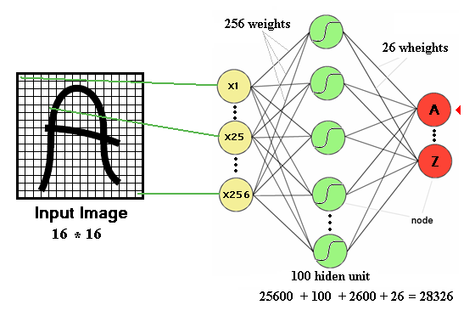
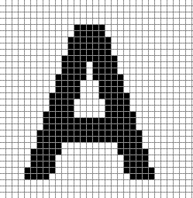
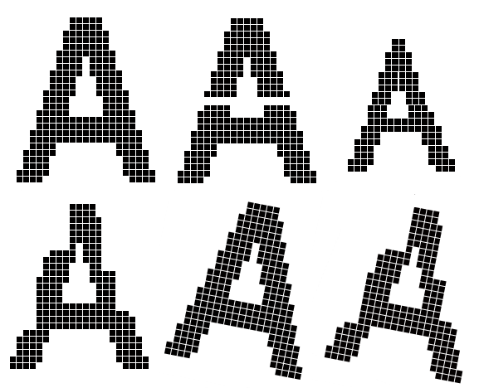
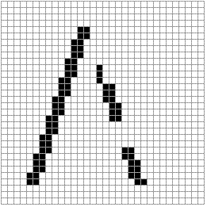
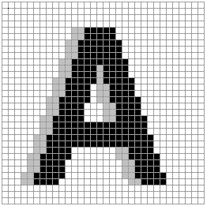
Neural networks - Disadvantages
The number of trainable parameters becomes extremely large
Little or no invariance to shifting, scaling, and other forms of distortion

Slide 7
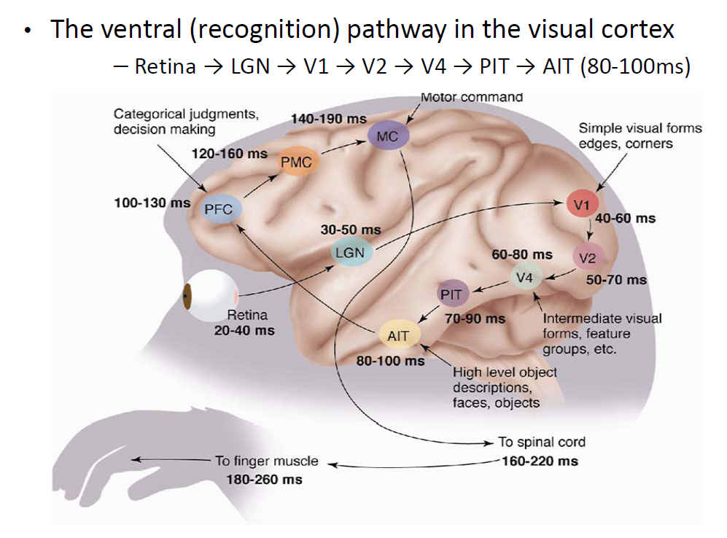
Mammalian visual pathway is hierarchical

Slide 8
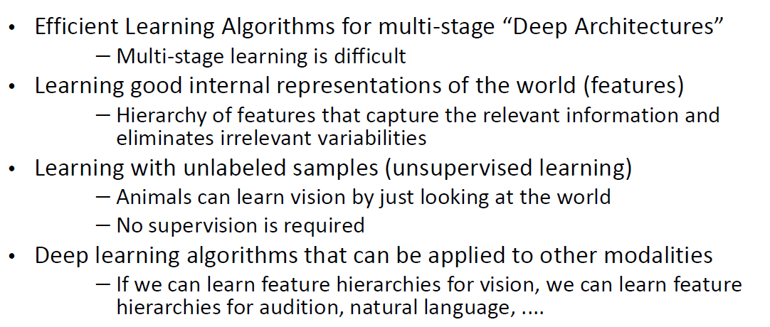
Some challenges for machine learning in vision

Slide 9
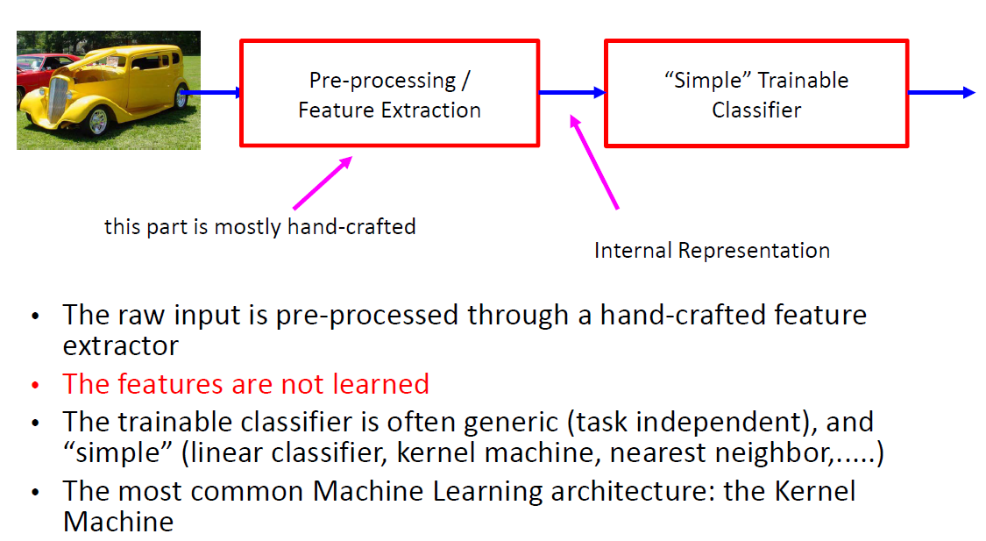
The traditional “shallow” architecture for recognition

Slide 10
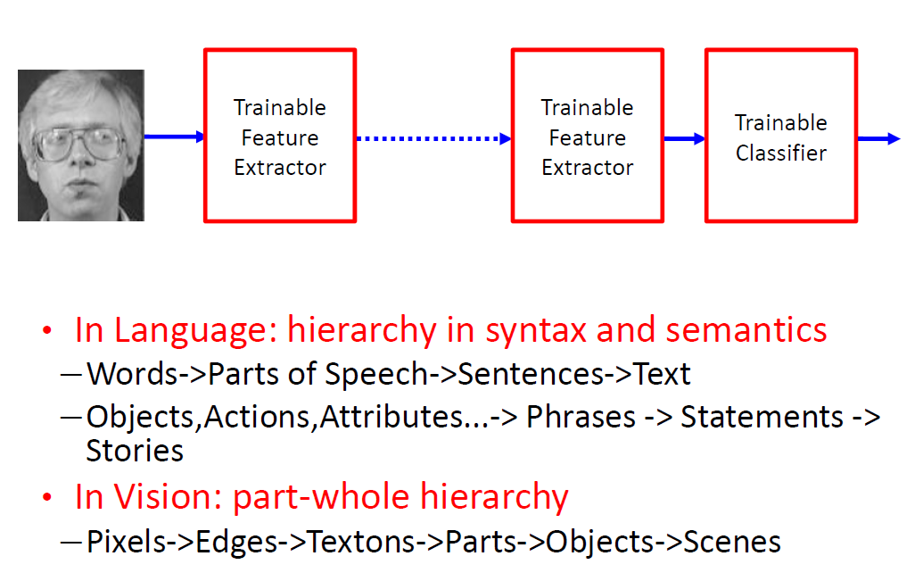
Good representations are hierarchical

Slide 11
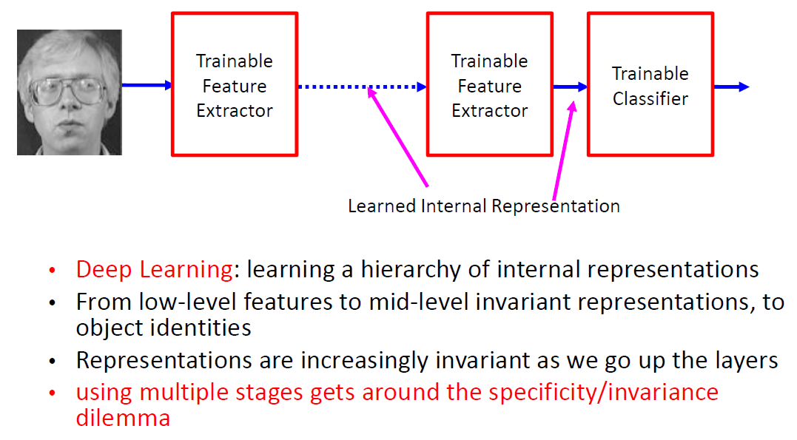
“Deep” learning: learning hierarchical representations

Slide 12
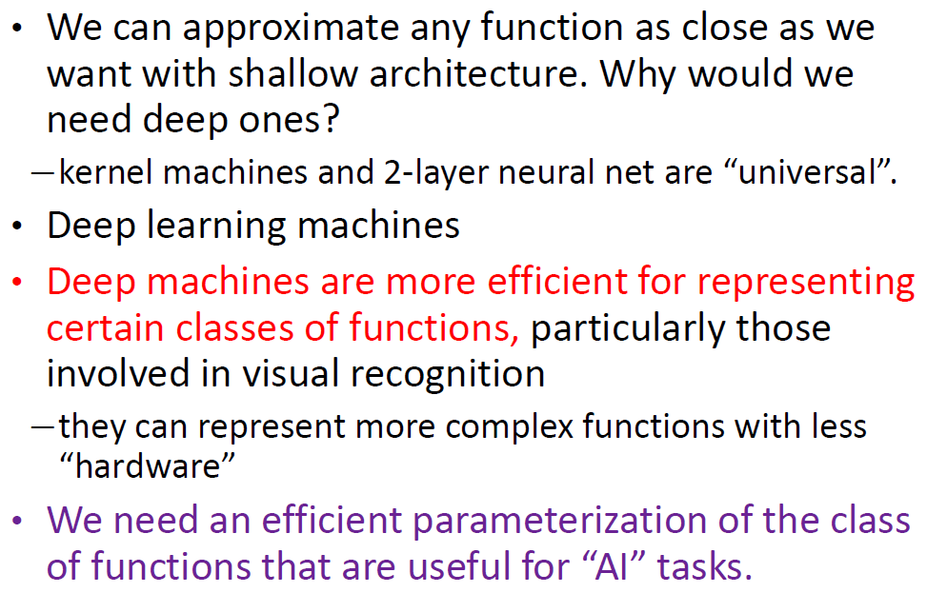
Do we really need deep architecture?

Slide 13
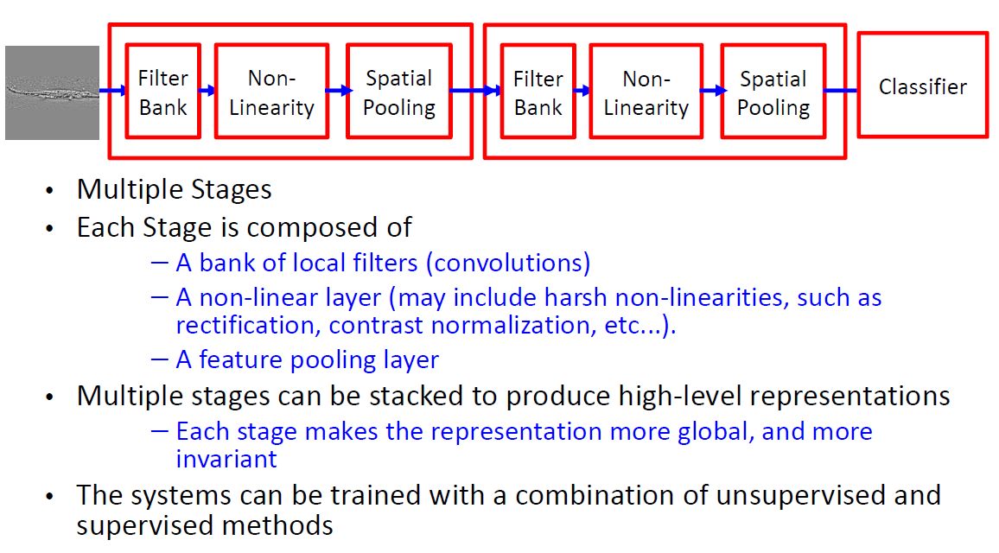
Hierarchical / deep architectures for vision

Slide 14
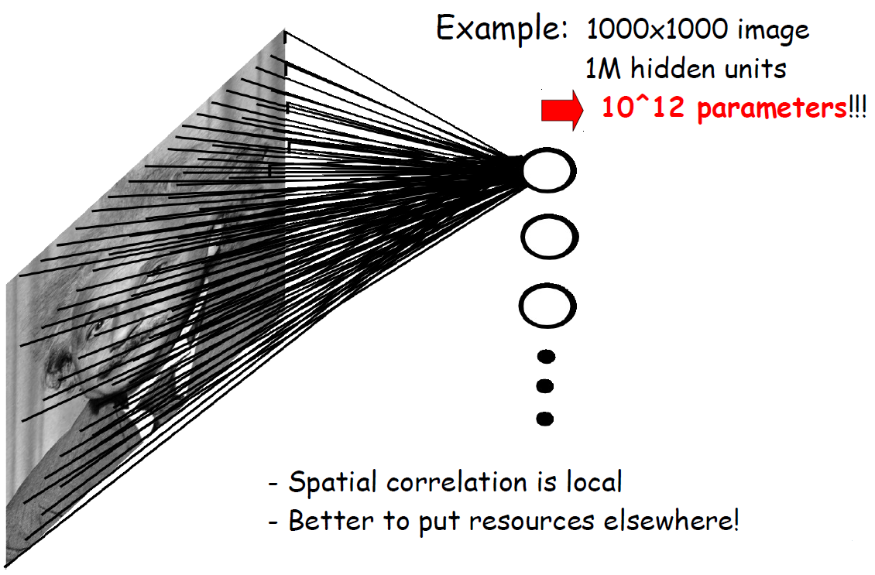
Fully connected neural networks

Slide 15
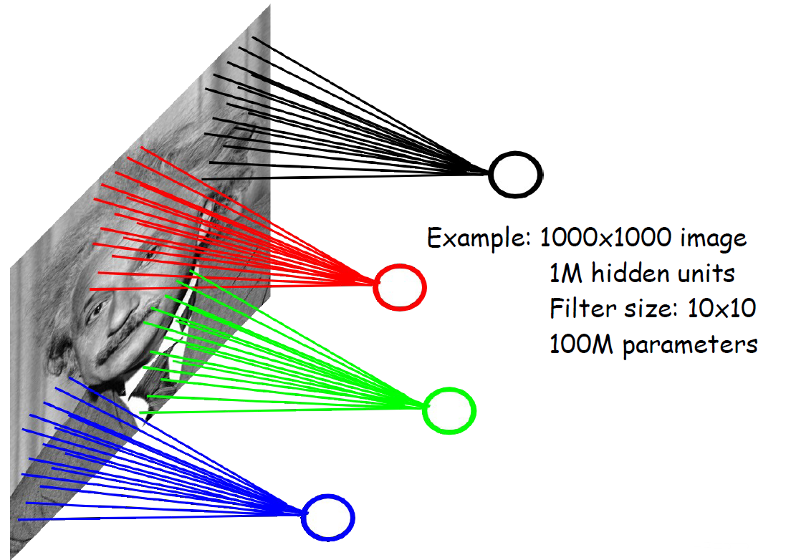
Locally connected neural networks

Slide 16
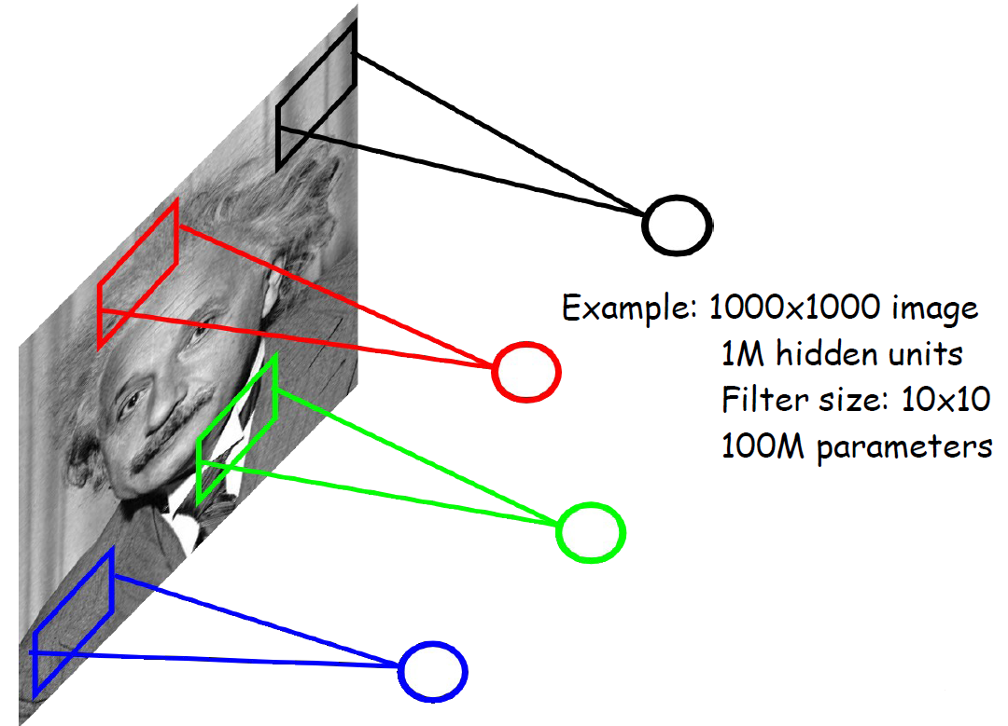
Locally connected neural networks

Slide 17
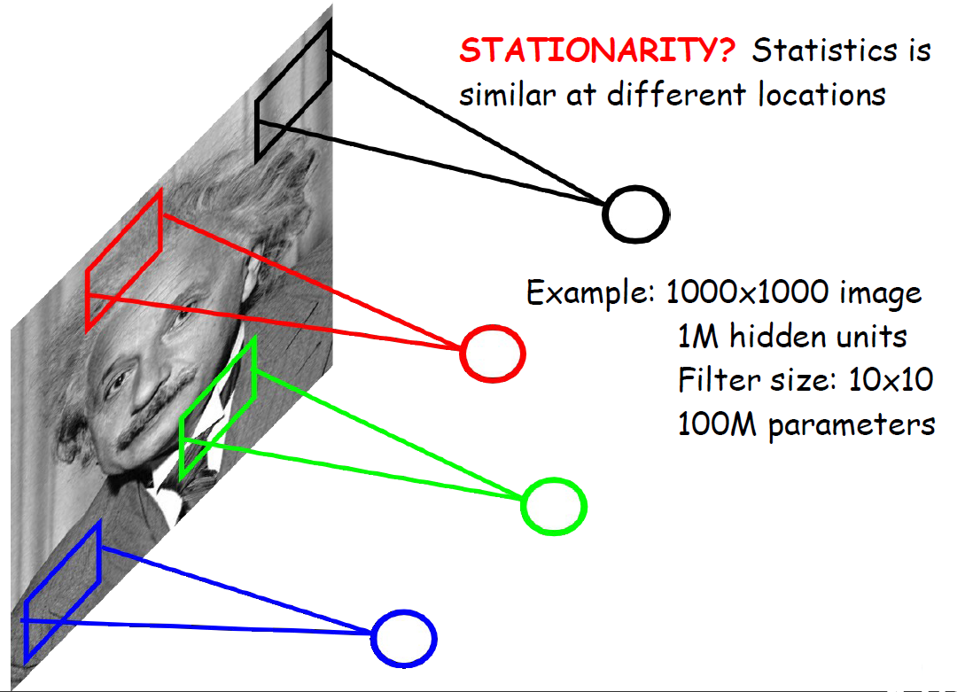
Locally connected neural networks

Slide 18
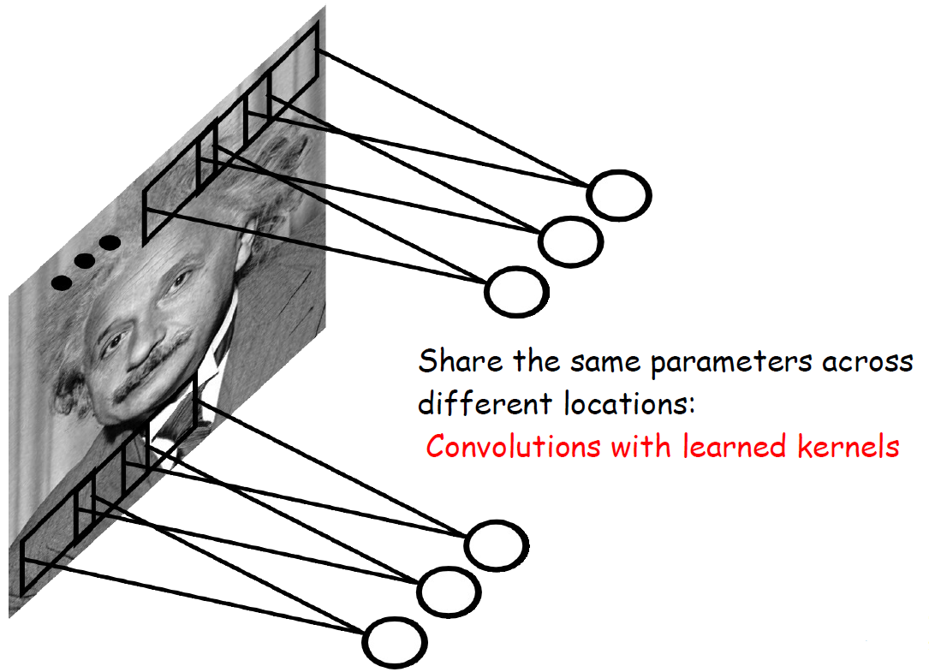
Convolutional Network

Slide 19
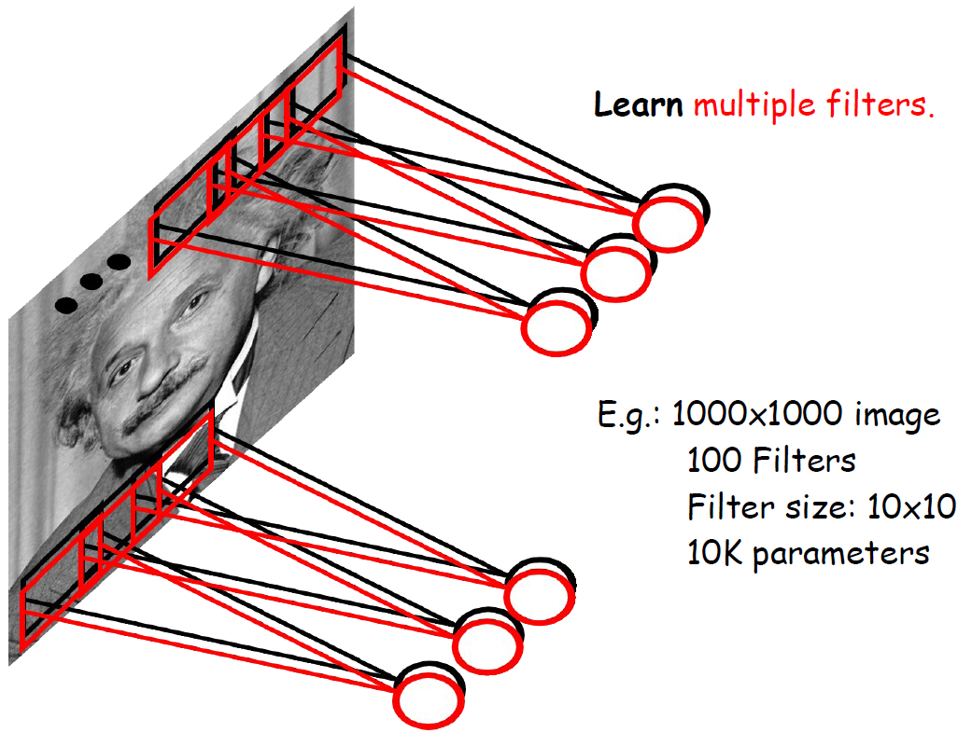
Convolutional Network

Slide 20
Neural network for vision
A standard neural network applied to images:
Scales quadratically with the size of the input
Does not leverage stationarity
Solution:
Connect each hidden unit to a small patch of the input
Share the weight across hidden units
This is called: convolutional network

Slide 21
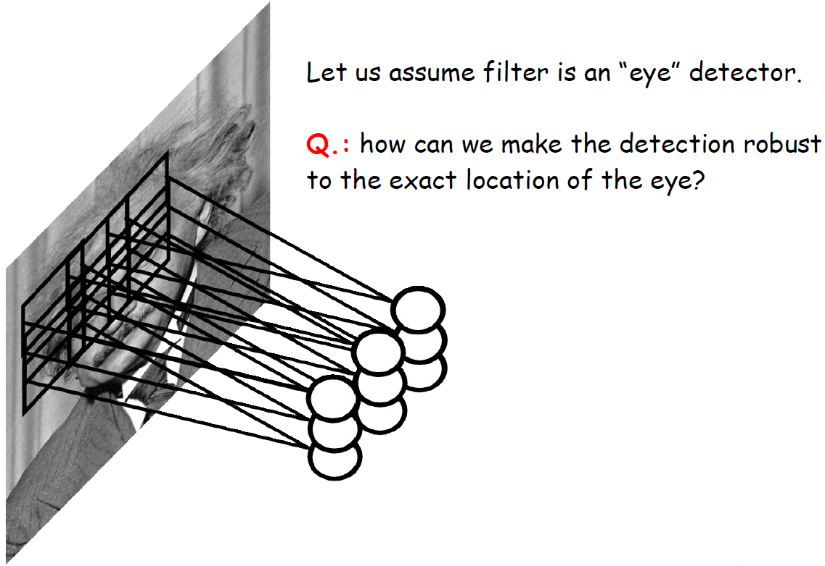
Convolutional network

Slide 22
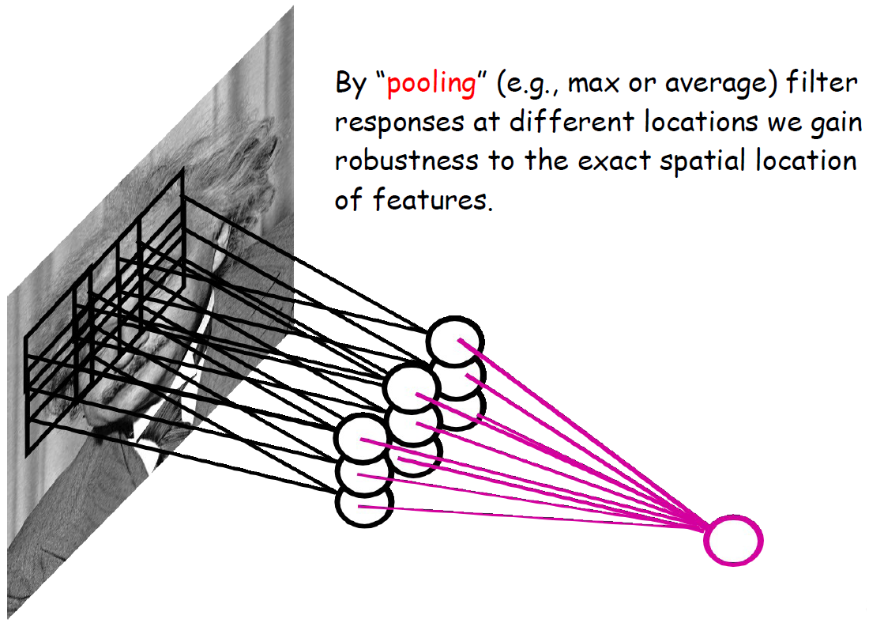
Convolutional network

Slide 23
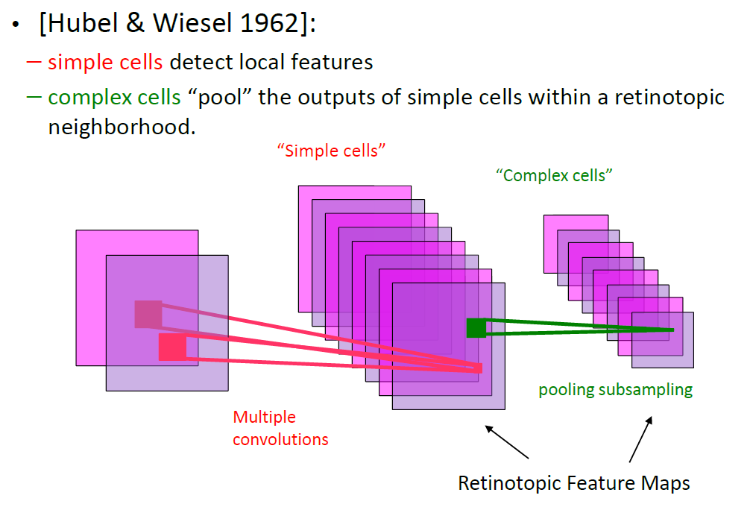
Filtering + Nonlinearity + Pooling = 1 stage of a Convolutional Network

Slide 24
Convolutional Neural networks
CNN is a feed-forward network that can extract topological properties from an image.
Like almost every other neural networks they are trained with a version of the back-propagation algorithm.
They can recognize patterns with extreme variability (such as handwritten characters).

Slide 25
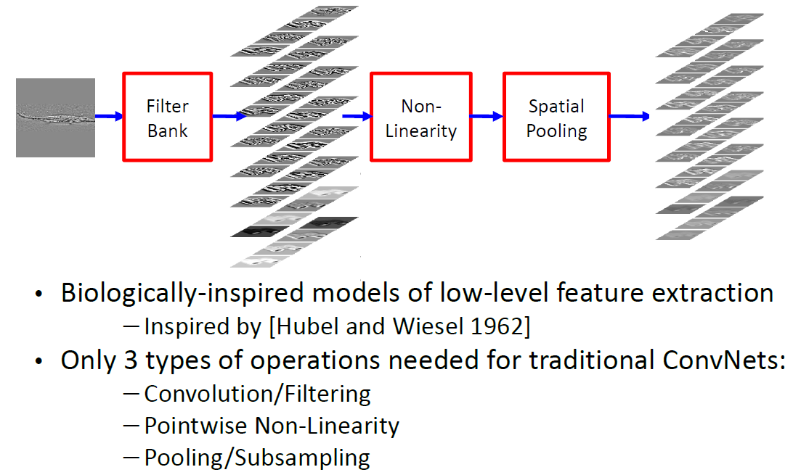
Feature extraction by filtering and pooling

Slide 26
Convolutional Neural networks
Feature maps
Feature extraction layer
Convolution layer
C
Shift and distortion invariance or
Subsampling layer
S

Slide 27
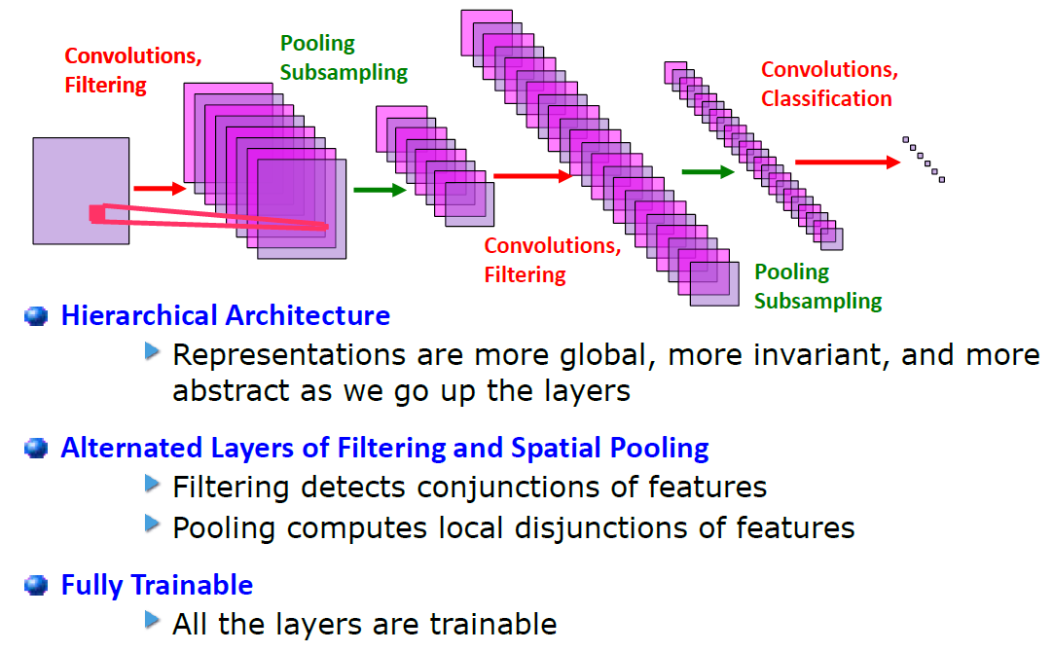
Convolutional Network: multi-stage trainable architecture

Slide 28

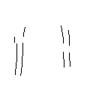


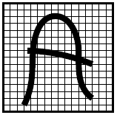


Convolutional layer or Feature extraction layer
-1
0
1
Convolve with
-1
0
1
features
-1
0
1
w11
w12
w13
w11
w12
w13
w21
w22
w23
w21
w22
w23
w31
w32
w33
w31
w32
w33

Slide 29


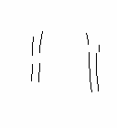


Convolutional layer or Feature extraction layer

Slide 30





Subsampling layer
Feature map
By reducing the spatial resolution of the feature map, reduce the effect of noises and shift or distortion.
the weight sharing is also applied in subsampling layers

Slide 31
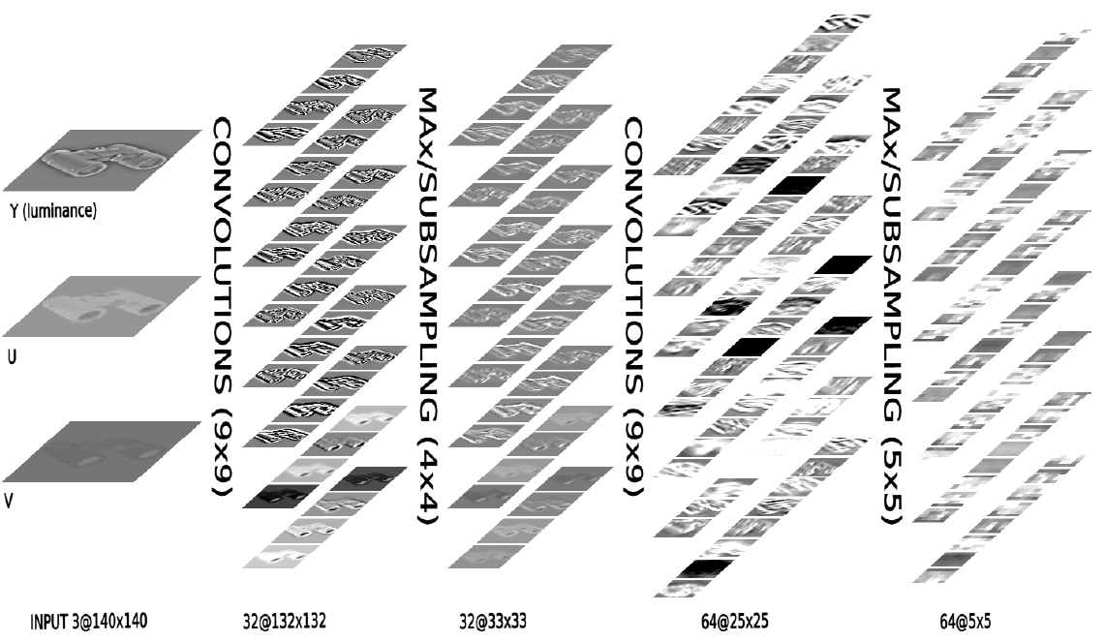
Convolutional network architecture

Slide 32
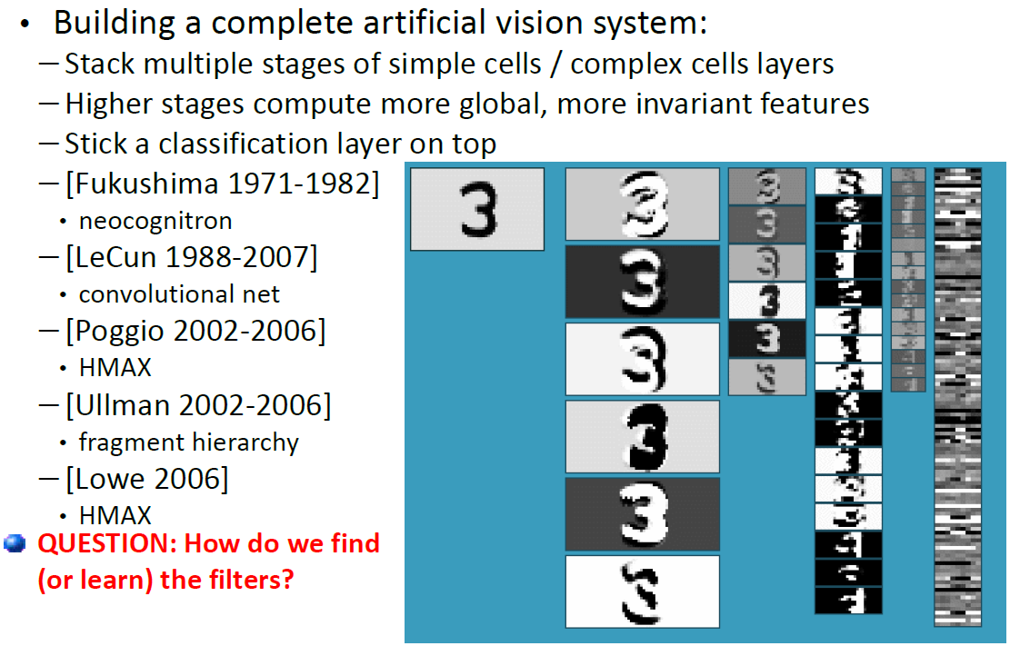
Convolutional Nets and other multistage Hubel-Wiesel architecture

Slide 33

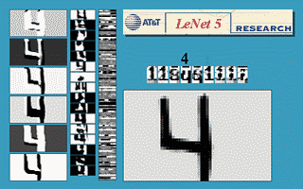
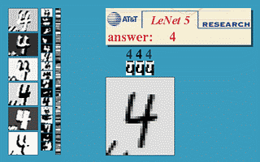
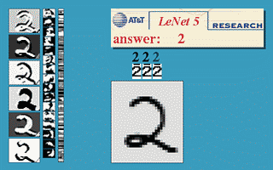
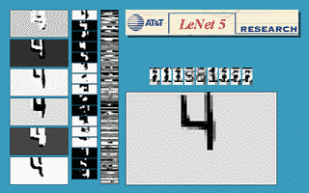
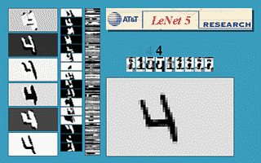
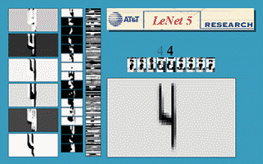

Convolutional networks architecture for hand-writing recognition

Slide 34

Convolutional networks architecture for hand-writing recognition

Slide 35

MNIST handwritten digit dataset

Slide 36

Invariance and robustness to noise

Slide 37

Scene Parsing
Scene parsing using inference Embedded Deep Networks

Slide 38

Scene Parsing
Scene parsing using inference Embedded Deep Networks

Slide 39


Human Pose Estimation
Joint Training of a Convolutional Network and a Graphical Model for Human Pose Estimation

Slide 40

Human Pose Estimation
Joint Training of a Convolutional Network and a Graphical Model for Human Pose Estimation

Slide 41

Face detection and pose estimation: results

Slide 42

Face detection: results

Slide 43

Learning object representations

Slide 44

Illustration: learning an “eye” detector

Slide 45




Learning object representations

Slide 46

Learning object representations

Slide 47
Disadvantages
At runtime the convolution operations are computationally expensive and take up about 67% of the time.
Learned model can not adapt to other domain.
Need large amount training samples.
Without memory capability
Need explicit structure inference

